Slide 1
Lecture 3.1: Signaling System No. 7

Slide 2
Content
SS7 system principle
Message transfer part (MTP) principle
ISDN user part (ISUP) message and application
Notes:
此页列出学习本课程需要达到的目标。
此页胶片仅在授课时使用，胶片＋注释中有单独的文字说明课程目标，不需要再使用该页胶片。

Slide 3
Signaling System No.7 (SS7)
Signaling is used for connection control, work coordination and “session” between communication devices
SS7 is formulated by CCITT (Consultative Committee for International Telephony and Telegraphy)and is widely applied in switched circuit networks (e.g. PSTN).

Slide 4




Section 1 MTP
Section 2 ISUP
Notes:
此页为了让学员和老师对课程安排有一个大致的了解。
此页列出本课程的主要培训标题，列出每章的名称即可。如果章下面的节不多，在此页可以一并列出。
此页胶片仅在授课时使用，胶片＋注释中有专门的目录和标题，不需要重复使用该页面。

Slide 5
SS7 Functional Structure
T
I
U
S
U
INAP
P
P
TCAP
User part
SCCP
Message
Transfer Part
MTP3
M3UA
MTP2
M2UA
SCTP
IP
MTP1
MAC

Slide 6
SS7 Functional Structure
SS7 has two parts:
  User Part (UP)
  Message Transfer Part (MTP).
MTP : enables reliable transfer of signaling messages between user functions.
  SS7 messages can be transmitted over
    narrowband TDM transmission network (i.e. MTP),
    over broadband IP network (the protocol used for transmitting SS7 over IP network is SIGTRAN.)
UP :
  the independent user part of different users
  it is the functional entity for various call services

Slide 7
MTP
Overview, MTP1, MTP2
MTP3

Slide 8
MTP - Overview
The main function
  to provide reliable signaling message transfer in the signaling network
Feature : has measures to avoid or reduce
  message loss
  repetition
  loss of sequence
MTP consists of three function levels:
  signaling data link (MTP1)
  signaling link function (MTP2)
  signaling network function (MTP3).

Slide 9
MTP1
MTP1 definition:
  Defining the physical, electric and functional characteristics of signaling data link, as well as access methods.
  Equivalent to the physical layer of OSI seven-layer protocol structure, and used to generate and receive the signals over physical channels
Signaling Data Link :
  A bidirectional transmission channel for a signaling.
  Composed of two-way data channels.
  The standard bit-rate is 64kbit/s
    which also can be applied to the transmission link with lower rate (such as 4.8kbit/s) or that with higher rate (2048kbit/s)

Slide 10
MTP2
MTP2 definition:
  Having a Signaling link function.
  It is used to transmit signaling to data link, and cooperates with MTP1 to ensure reliable signaling link between two directly connected signaling points.
Signaling link function can be sub-divided into
  signaling unit delimitation
  signaling unit location
  error detection
  error correction,
  initial location
  processor failure
  level-two flow control
  and signaling link error rate monitoring functions.

Slide 11
MTP
Overview, MTP1, MTP2
MTP3

Slide 12
MTP3
Definition :
  Network layer
  It implements the functions of the third layer of OSI
  used to transmit management messages to ensure reliable transmission of signaling messages in case of faults in signaling link or signaling transfer point

Slide 13
Signaling Message Processing
Message routing function:
  To determine the outgoing signaling link for transmitting messages to destination point
Message identification function:
  To check whether the destination signaling point in received message is a local office signaling point
Message allocation function:
  To distribute received messages (sent to the point) to corresponding UPs

Slide 14
Signaling Network Management
Signaling service management:
  To transfer signaling service from one link or route to one or multiple different links or routes, reset MTP in a signaling point or slow down the traffic in case of congestion
Signaling link management:
  To recover faulty signaling link, activate idle (non-arranged) links, and deactivate arranged signaling links.
Signaling route management:
  To distribute the messages related to signaling network status, block or unblock signaling routes

Slide 15
Message Format
MTP has three basic signaling unit formats:
  Message Signaling Unit (MSU)
    To transmit messages of respective UPs, signaling network management messages as well as signaling network test and maintenance messages.)
  Link Status Signaling Unit (LSSU)
    LSSU provides the link status information to perform the connection and recovery of signaling links
  Fill-In Signaling Unit (FISU)
    FISU is used to maintain normal operation of the signaling link and implement fill-in function when no MSU or LSSU is transmitted over the signaling link.

Slide 16
Section 1 MTP
Section 2 ISUP
Notes:
此页为了让学员和老师对课程安排有一个大致的了解。
此页列出本课程的主要培训标题，列出每章的名称即可。如果章下面的节不多，在此页可以一并列出。
此页胶片仅在授课时使用，胶片＋注释中有专门的目录和标题，不需要重复使用该页面。

Slide 17
ISUP Signaling
Overview
Call process

Slide 18
ISUP - Overview
ISUP is one of UPs of Common Channel Signaling System No.7.
It provides necessary signal functions for supporting basic bearer services and supplementary services of voice and non-voice purposes in the Integrated Service Digital Network (ISDN).

Slide 19
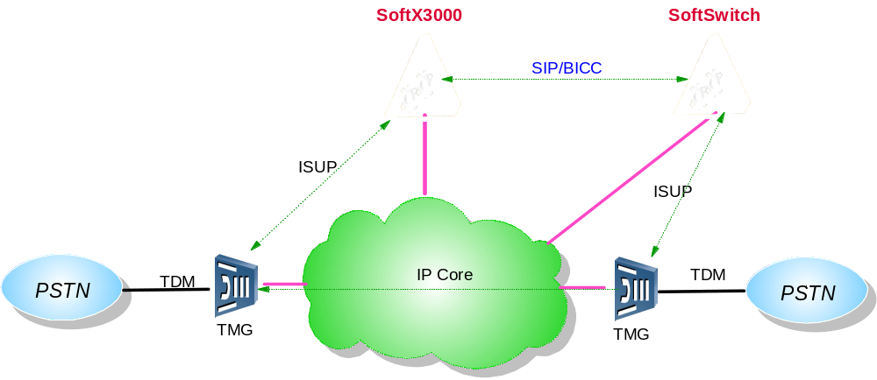
Applications in SoftX3000

Slide 20
Protocol Stack
ISUP
User part
Message transfer part
MTP3
M3UA
M2UA
MTP2
SCTP
IP
MTP1
MAC

Slide 21
ISUP Signaling
Overview
Call process

Slide 22
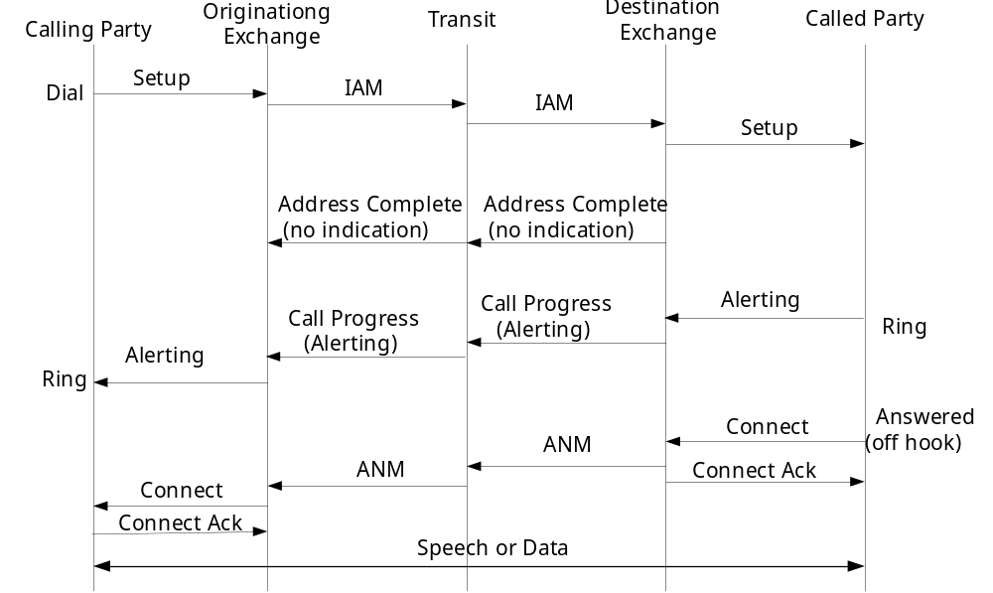
Successful Call Setup

Slide 23
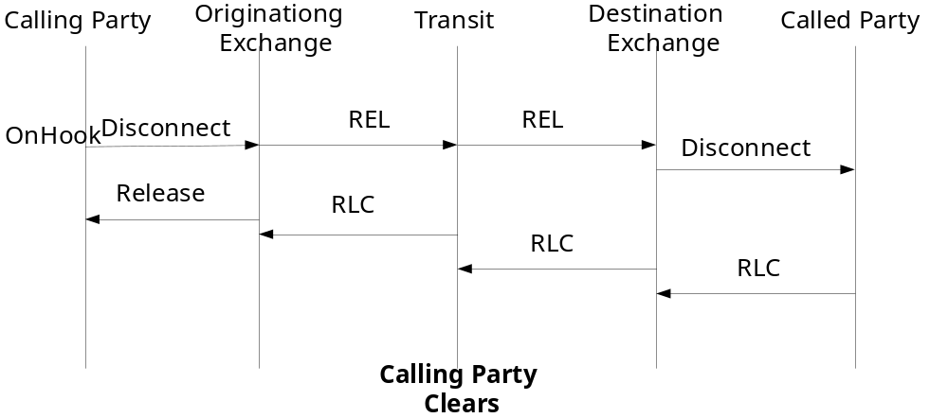
Successful Call Release (1)

Slide 24
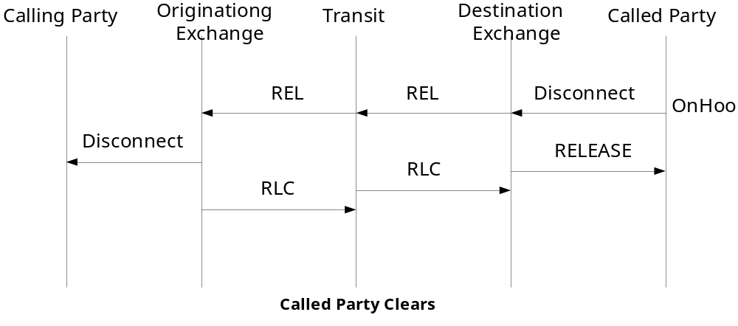
Successful Call Release (2)

Slide 25
Summary
SS7 signaling includes two parts: Message Transfer Part (MTP) and User Part (UP).
The MTP consists of MTP1, MTP2 and MTP3
ISUP is one of UPs of SS7. It provides necessary signal functions for supporting basic bearer services and supplementary services of voice and non-voice purposes in the integrated service digital network.

